Slide 1

Performance Prediction of Asphalt Mixtures using Heterogeneous Properties
Project evaluation for partial fulfillment of M.Tech degree
Transportation Engineering
Department of Civil Engineering
Presented by
Vivek Kumar Singh
(220CE3462)
NIT Rourkela
Guided by
Dr. Gourab Saha
Assistant Professor
NIT Rourkela

Slide 2
Introduction
A flexible pavement structure is typically composed of several layers of materials. Each layer receives loads from the above layer, spreads them out, and passes on these loads to the next layer below. Thus the stresses will be reduced, which are maximum at the top layer and minimum on the top of subgrade.
Flexible pavements will transmit wheel load stresses to the lower layers by grain-to-grain transfer through the points of contact in the granular structure.
The different layers are usually arranged in the order of descending load bearing capacity with the highest load bearing capacity material (and most expensive) on the top and the lowest load bearing capacity material (and least expensive) on the bottom.

Slide 3
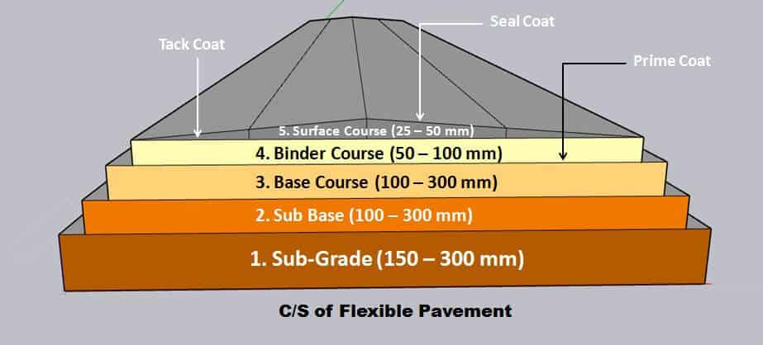
Introduction[Contd.]

Slide 4
Objective
To asses the performance of asphalt mixtures due to the application of dynamic loading on the flexible pavement with heterogeneous asphalt layer.

Slide 5
Literature Review
Author | Year | Findings
Castillo et. al. | 2018 | A higher variability in the mechanical properties of the AC layer, produced higher variation in AC layer strain. Sectional method is cheaper and less time consuming than microstructural model.
Castillo et. al. | 2019 | Variability in AC layer affect the overall response of the pavement structure.
Coleri and Harvey | 2013 | For thick bituminous layer deformation due to shear strain do not affect the bottom part of the layer.
Yin et. al. | 2014 | Distribution of coarse aggregate change the direction of crack propagation locally but has a slight influence in the direction of overall crack.
Xu and Chang | 2014 | A higher geospatial heterogeneity of material elastic moduli resulted in higher response values of deflection, tensile stress and strain.
Gamez et. al. | 2018 | Introduced domain analysis method to find bulk volume response of pavement.

Slide 6
Literature Review[Contd.]
Author | Year | Findings
Wang et. al. | 2020 | The value of strains obtained from the dynamic loading should be 10-15 % higher than strains produced from static loading.
Cho et. al. | 2018 | Dynamic response of flexible pavement depends upon contact area and size of mesh.
Han et. al. | 2021 | The method in which heterogeneous asphalt mixture is considered to be composed of disperse phase including coarse aggregate, air voids and continuous phase including fine asphalt matrix is reliable for reconstructing the heterogeneous structure of asphalt mixture with relatively low content of air voids.

Slide 7
Literature Review[Contd.]
Author | Year | Findings
Bayat and Knight | 2012 | The value of dynamic strain is 10-15% higher than the value of static strain.
Ahmed et. al. | 2015 | The horizontal strain in AC layer and vertical strain on top of AC, base, subbase and subgrade are highly sensitive to temperature.
Yoo and Al-Qadi | 2007 | The value of rutting and fatigue strains are underestimated when mass inertia and damping force exerted by transient local dynamic load is ignored.
Cebon | 2010 | Dynamic component of the wheel load reduces the service life of the pavement.
Masad et. al. | 2002 | First time invested cross-anisotropy in AC layer.

Slide 8
Literature Review(Research gap)
Various researchers have worked regarding heterogeneity of AC layer. When analysing pavement responses, they have mainly focus on studying the appearance and development of damage in the pavement materials.
There is a very little work found regarding the impact on thickness of different layers of flexible pavement due to different level of heterogeneity in AC layer which plays an important role for effective design of flexible pavement.

Slide 9
Problem Statement
The design of flexible pavement is performed using IRC 37 with the help of elastic layered theory in which the different layers of the pavement is assumed as homogenous and static loading is considered for design.
But in reality the its not the case.
So to make the design effective it is important to take heterogeneous behaviour of different layers and dynamic loading.

Slide 10
Scopes
Comprehensive literature review.
Design of pavement using IRC 37.
Design a simple model using finite element method.
Compare the results of IITPAVE and ABAQUS.
Design a real model using finite element method.
Evaluate the effects on layer thickness.

Slide 11
Methodology
A most economical section of the flexible pavement is found with the help of IITPAVE software and IRC 37-2018.
A pavement section by applying same guidelines of IRC 37-2018 is created in ABAQUS software and strains are calculated.
The values of strains obtained from ABAQUS model did not match with IITPAVE results. So the ABAQUS model is calibrated in such a way that the value of strain should get nearly equal to IITPAVE results.
A dynamic loading is applied on the pavement model using ABAQUS to quantify the effect on design of flexible pavement.
A dynamic load is applied on flexible pavement with non-homogeneous asphalt layer to quantify the effects of heterogeneity of asphalt layer on the design of flexible pavement.
The results are presented with the help of different tables, graphs, figures etc.

Slide 12
Results and discussion
Static analysis of flexible pavement using IRC 37
Selecting a suitable pavement model for analysis
Cross section = 3.75m*3.75m (width of single lane)
To find the economical depth of different layers, IRC 37 is used for designing with following input parameters.
CBR = 7%
Traffic = 40 msa
VDF = 5.2
V_{a} = 4%
V_{be} = 11.5%
LDF = 0.75

Slide 13
Results and discussion[Contd.]
No of standard axles |  |  | 40000000 | sa | (from eq. 4.5 )
Resilient modulus of subgrade |  |  | 66.60245833 | Mpa | (from eq. 6.2 )
Trial thickness of different layers
Bituminous |  | 190 | mm
Granular layer |  | 450 | mm
Resilient modulus of granular layer |  |  |  | 208.1929 | Mpa | (from eq. 7.1)
Allowable vertical strain on subgrade (Rutting) |  |  |  |  | 0.00039 | (from eq. 3.2)
Allowable tensile strain on bituminous (Fatigue) |  |  |  |  | 0.000203 | (from eq. 3.4)
 | C | 3.155155 |  |  |  | (from eq. 3.4)
 | M | 0.499021 |  |  |  | (from eq. 3.4)

Slide 14
Results and discussion[Contd.]
Results obtained from IITPAVE software from various trial thickness

Slide 15
Results and discussion[Contd.]
A suitable model for the analysis of this research is found by performing a number of trials in IITPAVE.
Bituminous layer 163 mm
Granular layer 447 mm
Subgrade 500 mm

Slide 16
Results and discussion[Contd.]
Static analysis of flexible pavement using FEM (ABAQUS)

Slide 17

Results and discussion[Contd.]
Model obtained from ABAQUS

Slide 18
Results and discussion[Contd.]
Comparison of results obtained from IRC 37 and FEM

Slide 19
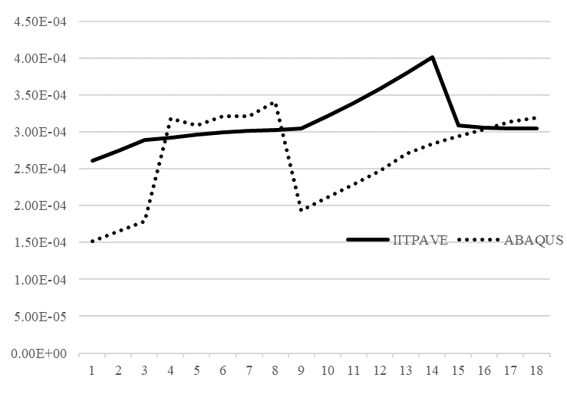
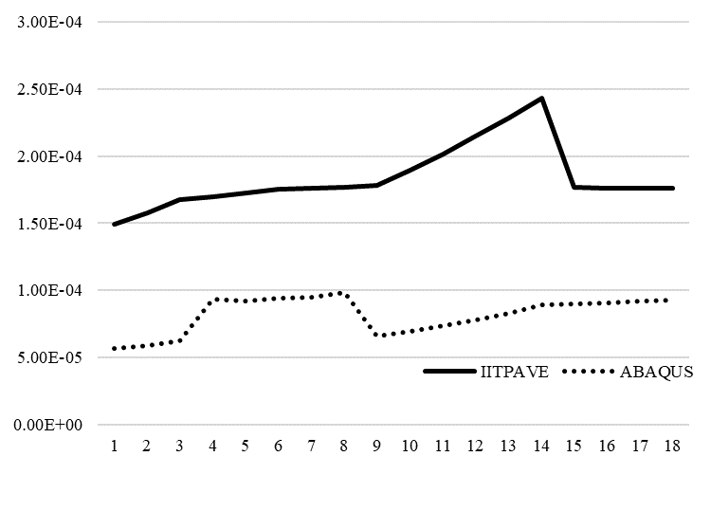
Results and discussion[Contd.]
Rutting strain
Fatigue strain

Slide 20
Results and discussion[Contd.]
Validation of FEM model for static loading
To calibrate the model a different values of mesh sizes are adopted and the values of critical strains are checked at each time.

Slide 21
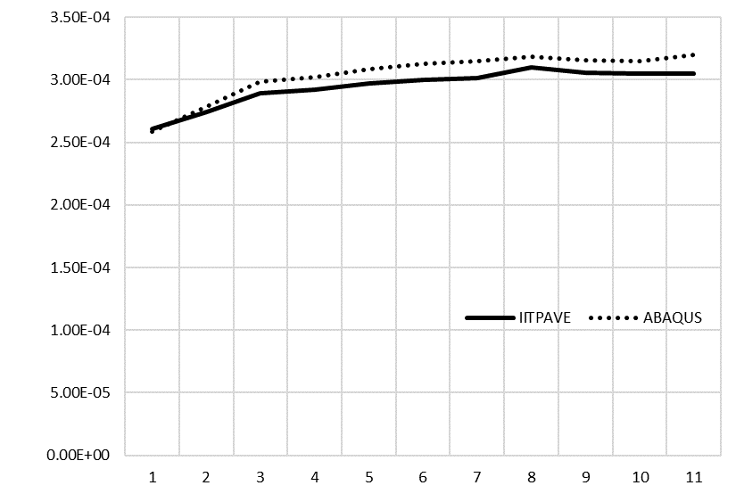
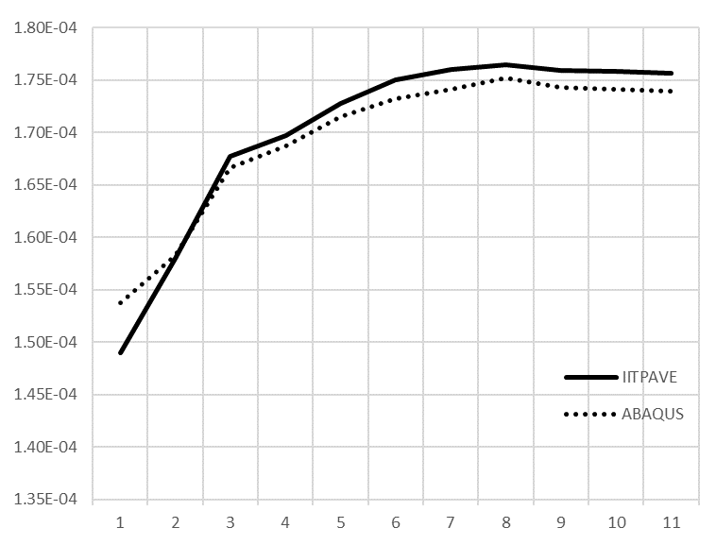
Results and discussion[Contd.]
Rutting strain
Fatigue strain

Slide 22
Results and discussion[Contd.]
Dynamic loading analysis
Variation of strains due to movement of vehicle
Speed of vehicle = 60 Kmph
Rutting strain
Fatigue strain

Slide 23
Results and discussion[Contd.]
Analysis of flexible pavement using dynamic load
Input parameters
Speed of the vehicle = 60 kmph.
Total time period = 0.225 seconds.
Peak load = 0.56 Mpa.
Sinusoidal loading curve.
Since one of the researchers Bayat and Knight (2012) has mentioned in his study that the value of strains obtained from the dynamic loading should be 10-15 % higher than strains produced from static loading. So our dynamic model needs a calibration to carry out further study.

Slide 24
Results and discussion[Contd.]
Validation of dynamic model
The dynamic model is calibrated by increasing the magnitude of load so that the value of dynamic strain comes higher than static strain.

Slide 25
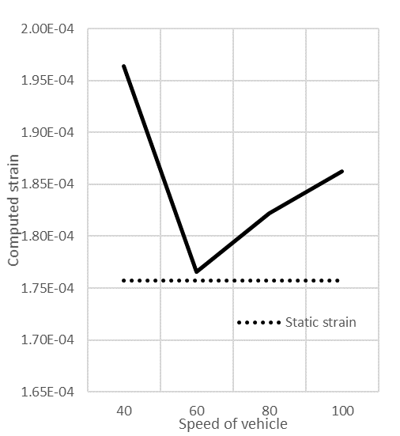
Results and discussion[Contd.]
Effect of speed of vehicle on the performance of flexible pavement
Whether the speed of vehicle is higher or lower, the value of dynamic strain is always higher than static strain.
Lower speed vehicle produces higher strain than high speed vehicle.

Slide 26
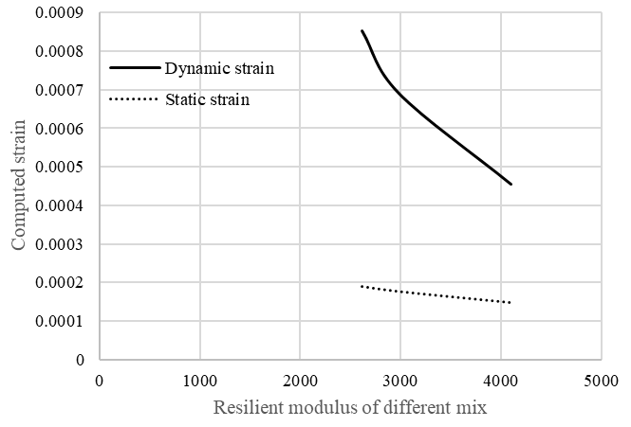
Results and discussion[Contd.]
Effect of different asphalt mix on dynamic strain
Input parameters
Temperature = 25⁰C
Frequency of loading = 10 Hz
Mix type
(Source: Saha, G. (2017))

Slide 27
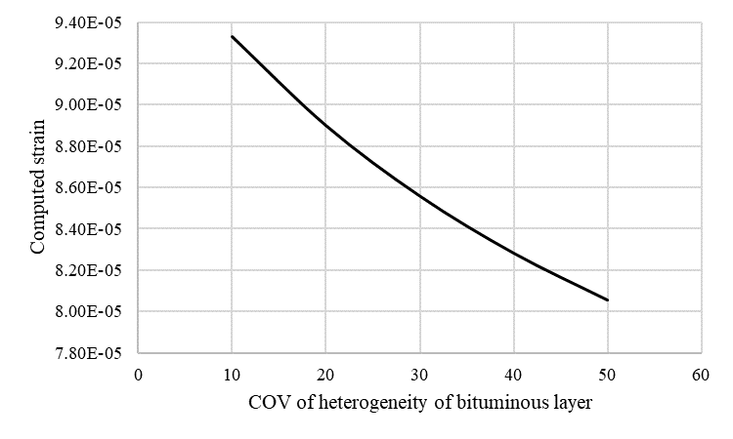
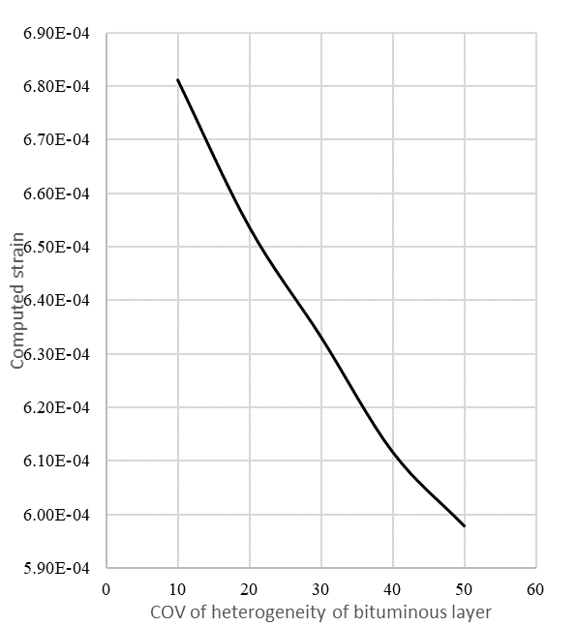
Results and discussion[Contd.]
Effect of non homogenous asphalt layer
Static loading
Dynamic loading

Slide 28
Results and discussion[Contd.]

Slide 29
Results and discussion[Contd.]
Effect of level of cross anisotropy in Asphalt layer

Slide 30
Findings
The strain produced from dynamic loading is always greater than the strain produced from static loading, whether the speed of the vehicle is more or less.
The value of cross-anisotropy of asphalt layer is inversely proportional to computed strain.
The rate of variation of magnitude of dynamic strain is higher than static strain with various type of mixes of different resilient modulus value.
Higher the resilient modulus of the asphalt mix lower the value of dynamic strain produced.
As the COV of asphalt layer increases, the magnitude of strain gets reduced which is produced due to application of dynamic loading on the flexible pavement with non-homogenous asphalt layer.
The magnitude of strain produced due to dynamic loading will be higher in case of flexible pavement with heterogeneous asphalt layer than the flexible pavement with homogenous asphalt layer.

Slide 31
Research significance
Since the magnitude of strain produced due to dynamic loading is always higher than static loading so the thickness of pavement designed using IRC 37-2018 will not be always suitable in dynamic case.
The required thickness of different layers of flexible pavement which is safe against dynamic loading also is slightly higher than static loading case.
The thickness of the flexible pavement constructed for high speed vehicles is lower than that of pavement constructed for slower vehicles.
The thickness of the pavement gets reduced if asphalt mix of higher resilient modulus value is used.
The COV of resilient modulus of asphalt layer affects the thickness of flexible pavement.

Slide 32
Limitations and future scope
This study has been conducted virtually using ABAQUS as a software for analysing the model. The accuracy of model creation depends on one’s experience.
The tyre imprint area is taken as circular for this study.
The strain values obtained from IRC 37-2018 has been used as a base for safe performance of flexible pavement during this study.
In this study only the effect of heterogeneity of one layer of flexible pavement is taken. We can extend this study further by taking effect of heterogeneity of others remaining layers of flexible pavement by applying dynamic loading.

Slide 33
References
Ahmed, M. U., Rahman, A. S. M. A., Islam, M. R., & Tarefder, R. A. (2015). Combined effect of asphalt concrete cross-anisotropy and temperature variation on pavement stress–strain under dynamic loading. Construction and Building Materials, 93, 685-694.
Aliha, M. R. M., Ziari, H., Sobhani Fard, E., & Jebalbarezi Sarbijan, M. (2021). Heterogeneity effect on fracture parameters of a multilayer asphalt pavement structure containing a top‐down crack and subjected to moving traffic loading. Fatigue & Fracture of Engineering Materials & Structures, 44(5), 1349-1371.
Allen, D. H., Little, D. N., Soares, R. F., & Berthelot, C. (2017). Multi-scale computational model for design of flexible pavement–part I: expanding multi-scaling. International Journal of Pavement Engineering, 18(4), 309-320.

Slide 34
References[Contd.]
Hernandez et. al. (2016) “Effect of Wide-Base Tires on Nationwide Flexible Pavement Systems”.
Bayat, A., & Knight, M. (2012). Field evaluation and analysis of flexible pavement structural responses under dynamic loads. Road materials and pavement design, 13(1), 26-37.
Behl, A., Kumar, G., Sharma, G., & Jain, P. K. (2013). Evaluation of field performance of warm-mix asphalt pavements in India. Procedia-social and behavioral sciences, 104, 158-167.
Castillo, D., & Al-Qadi, I. (2018). Importance of heterogeneity in asphalt pavement modeling. Journal of Engineering Mechanics, 144(8), 04018060.

Slide 35
References[Contd.]
Coleri, E., & Harvey, J. T. (2013). A fully heterogeneous viscoelastic finite element model for full-scale accelerated pavement testing. Construction and Building Materials, 43, 14-30.
Gamez, A., Hernandez, J. A., Ozer, H., & Al-Qadi, I. L. (2018). Development of domain analysis for determining potential pavement damage. Journal of Transportation Engineering, Part B: Pavements, 144(3), 04018030.
Ghadimi, B., & Nikraz, H. (2017). A comparison of implementation of linear and nonlinear constitutive models in numerical analysis of layered flexible pavement. Road Materials and Pavement Design, 18(3), 550-572.
Hadi, M. N., & Bodhinayake, B. C. (2003). Non-linear finite element analysis of flexible pavements. Advances in Engineering Software, 34(11-12), 657-662.

Slide 36
Thank you

